Slide 1
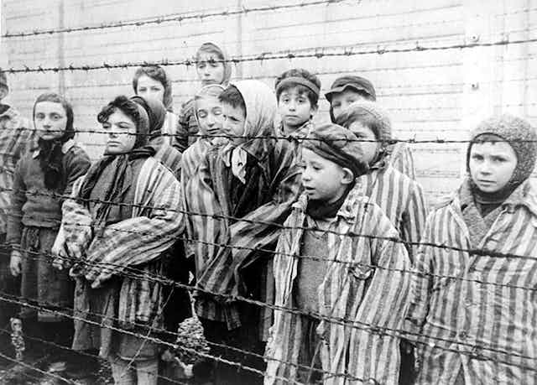
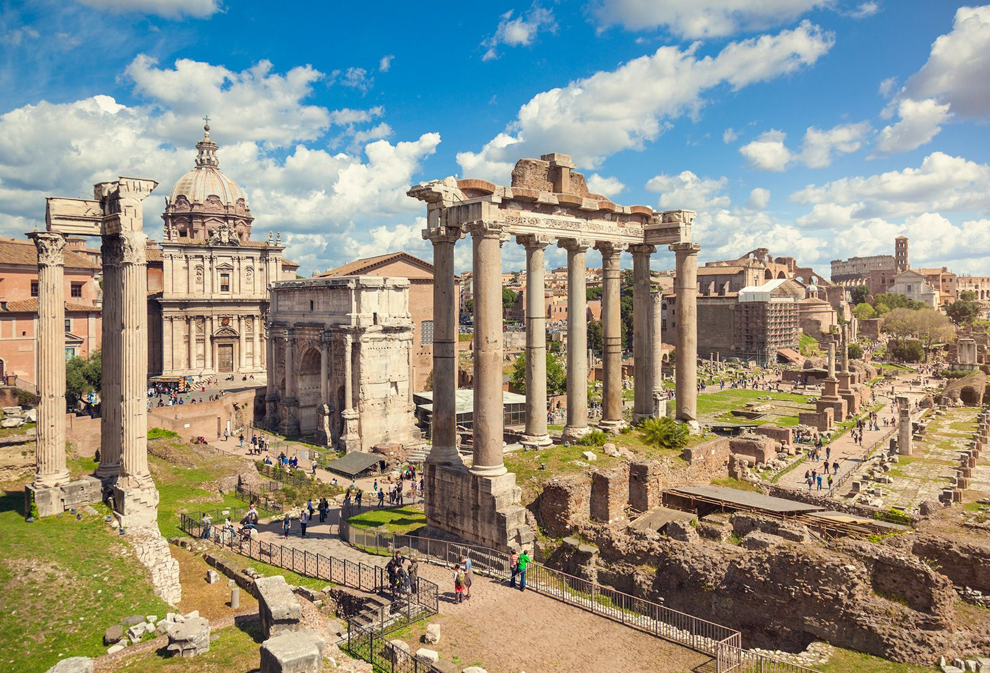
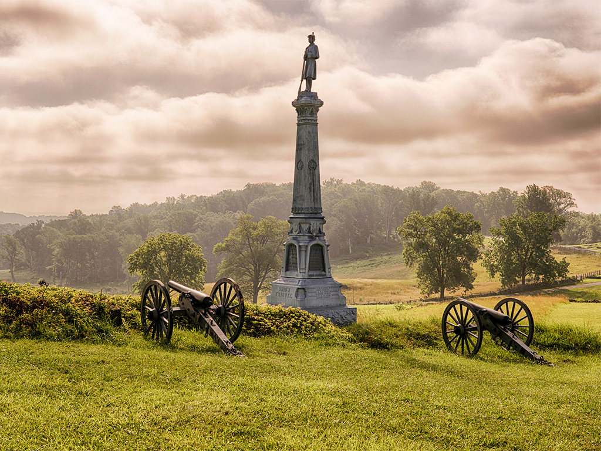
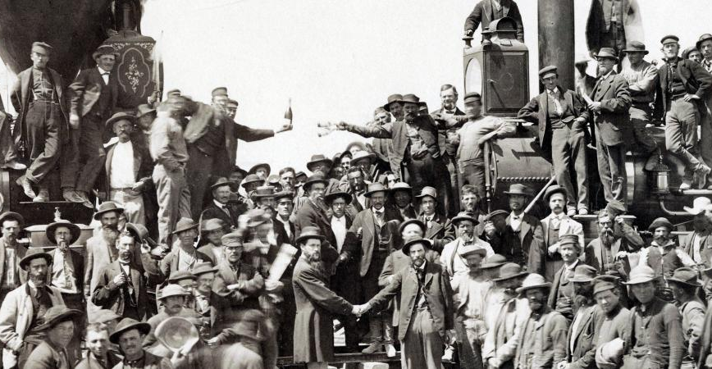
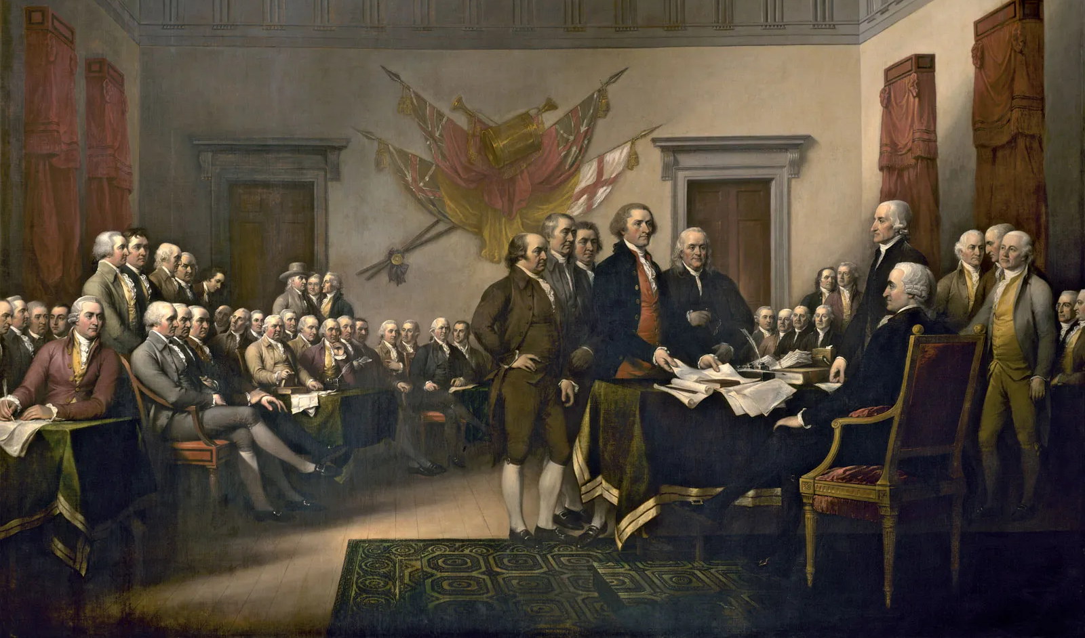
Why Study History?

Slide 2
Why Study History?
On a sheet of paper, list as many reasons you can think of as to why we should take time to study history.
Video

Slide 3
Why Study History?
History helps us understand how the society we live in came to be.
It gives us an understanding of people and cultures.
History helps us learn from the past to hopefully make a better future.

Slide 4
Why Study History?
History is fun, exciting, interesting, and downright AWESOME!!!
Video

Slide 5
Why Study History?
Assignment:
-Ask three non-7th graders the following questions:
Do you like learning about history and why?
Do you think it's important to learn about history and why?
What is your favorite thing to learn about history?

